Slide 1
Densify Point Clouds Sprint 2 Technical
By Group A2_9: Chris, Risa, and Brian

Slide 2
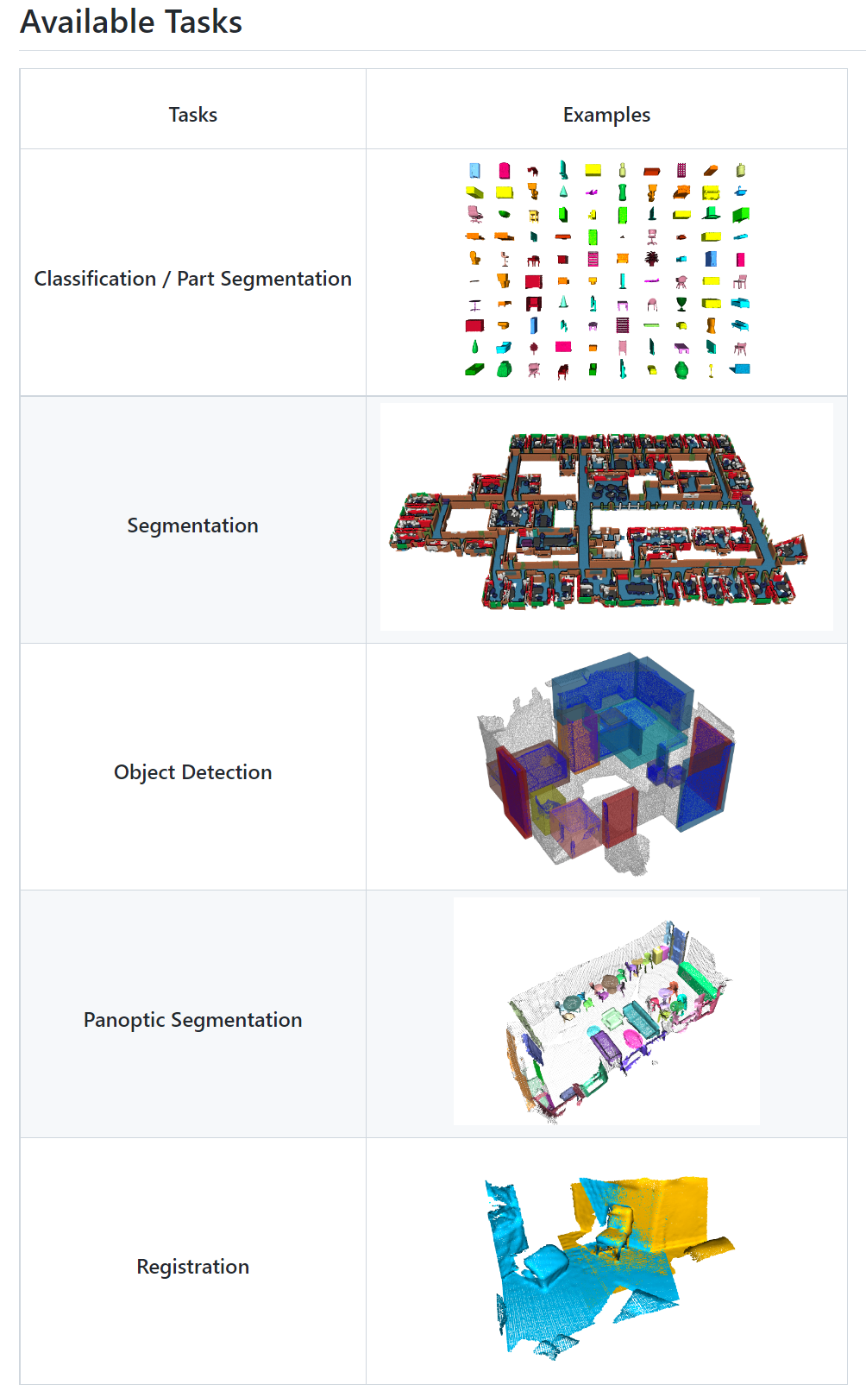
Classification: ModelNet from Zhirong Wu 3D ShapeNets: A Deep Representation for Volumetric Shapes
Segmentation/Detection: ScanNet: Richly-annotated 3D Reconstructions of Indoor Scenes
Registration:The IRALab Benchmark from Simone Fontana: Benchmark for point Cloud Registration Algorithms

Slide 3
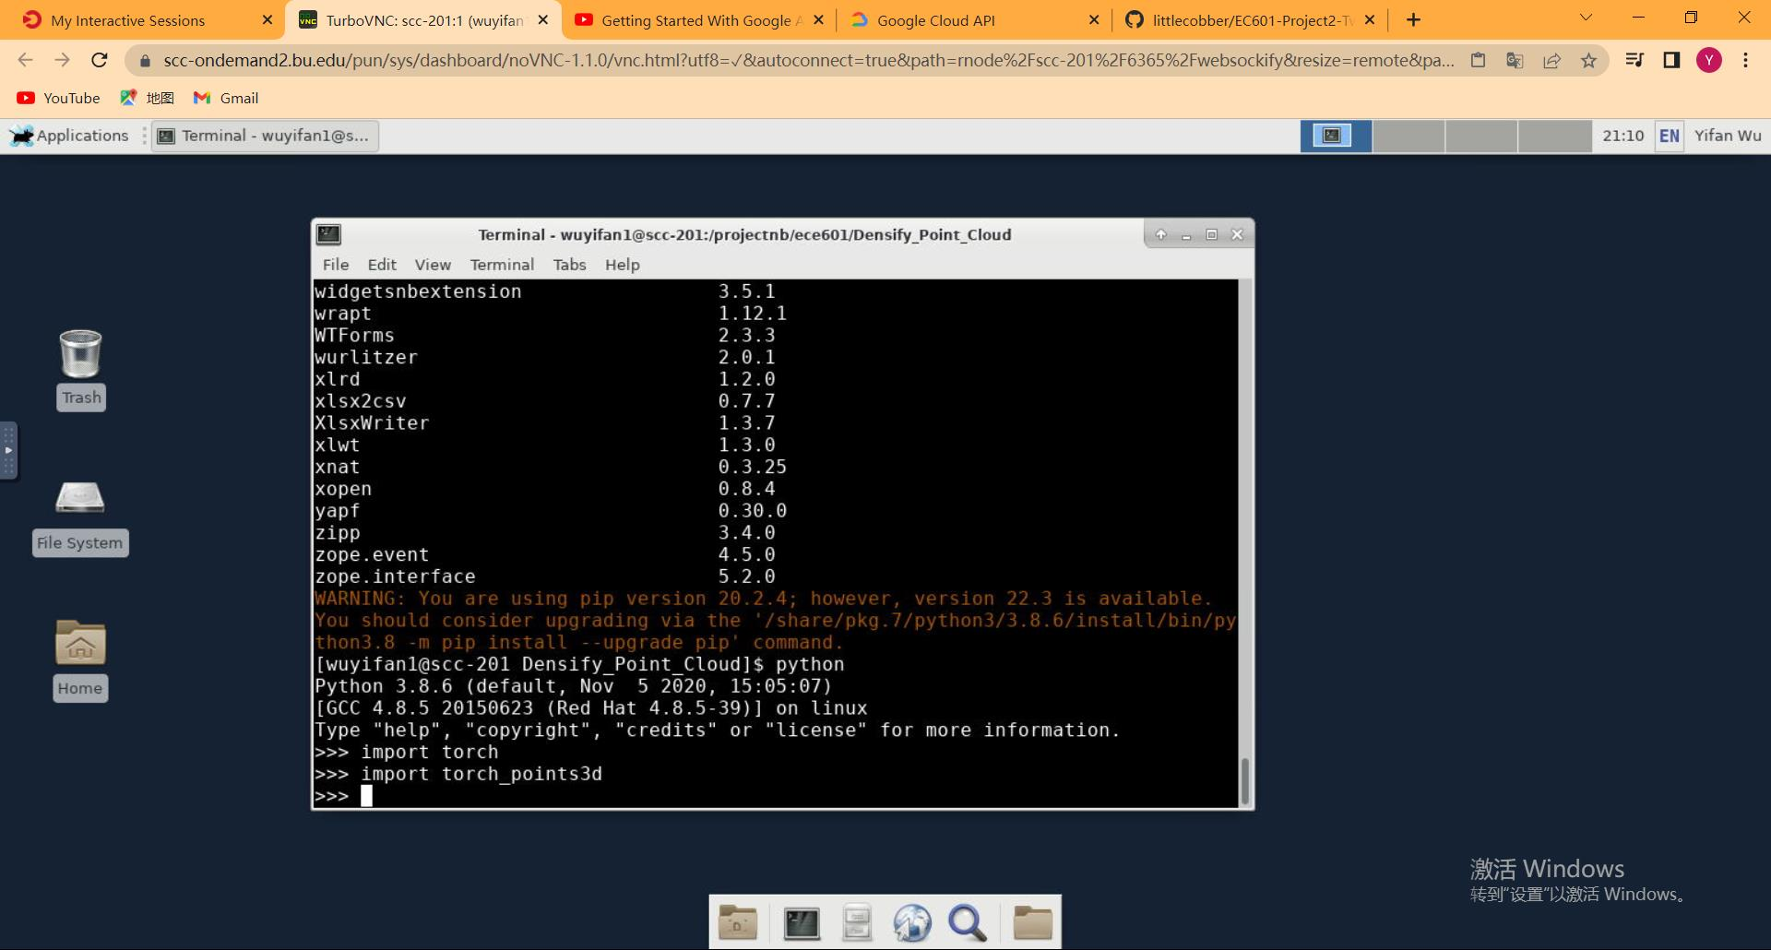
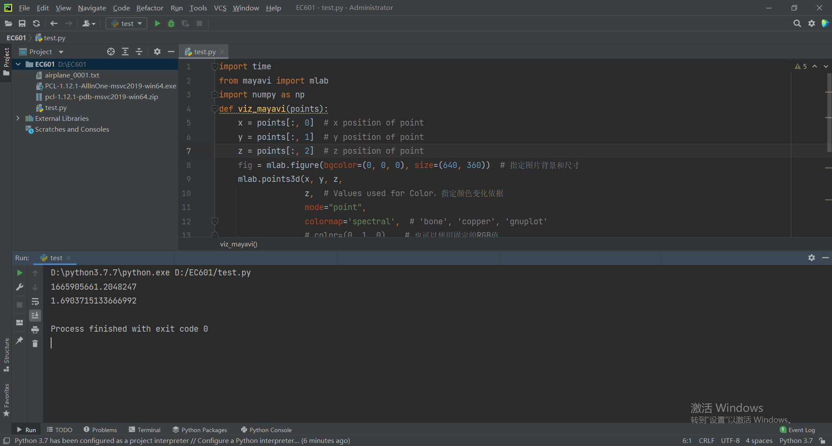
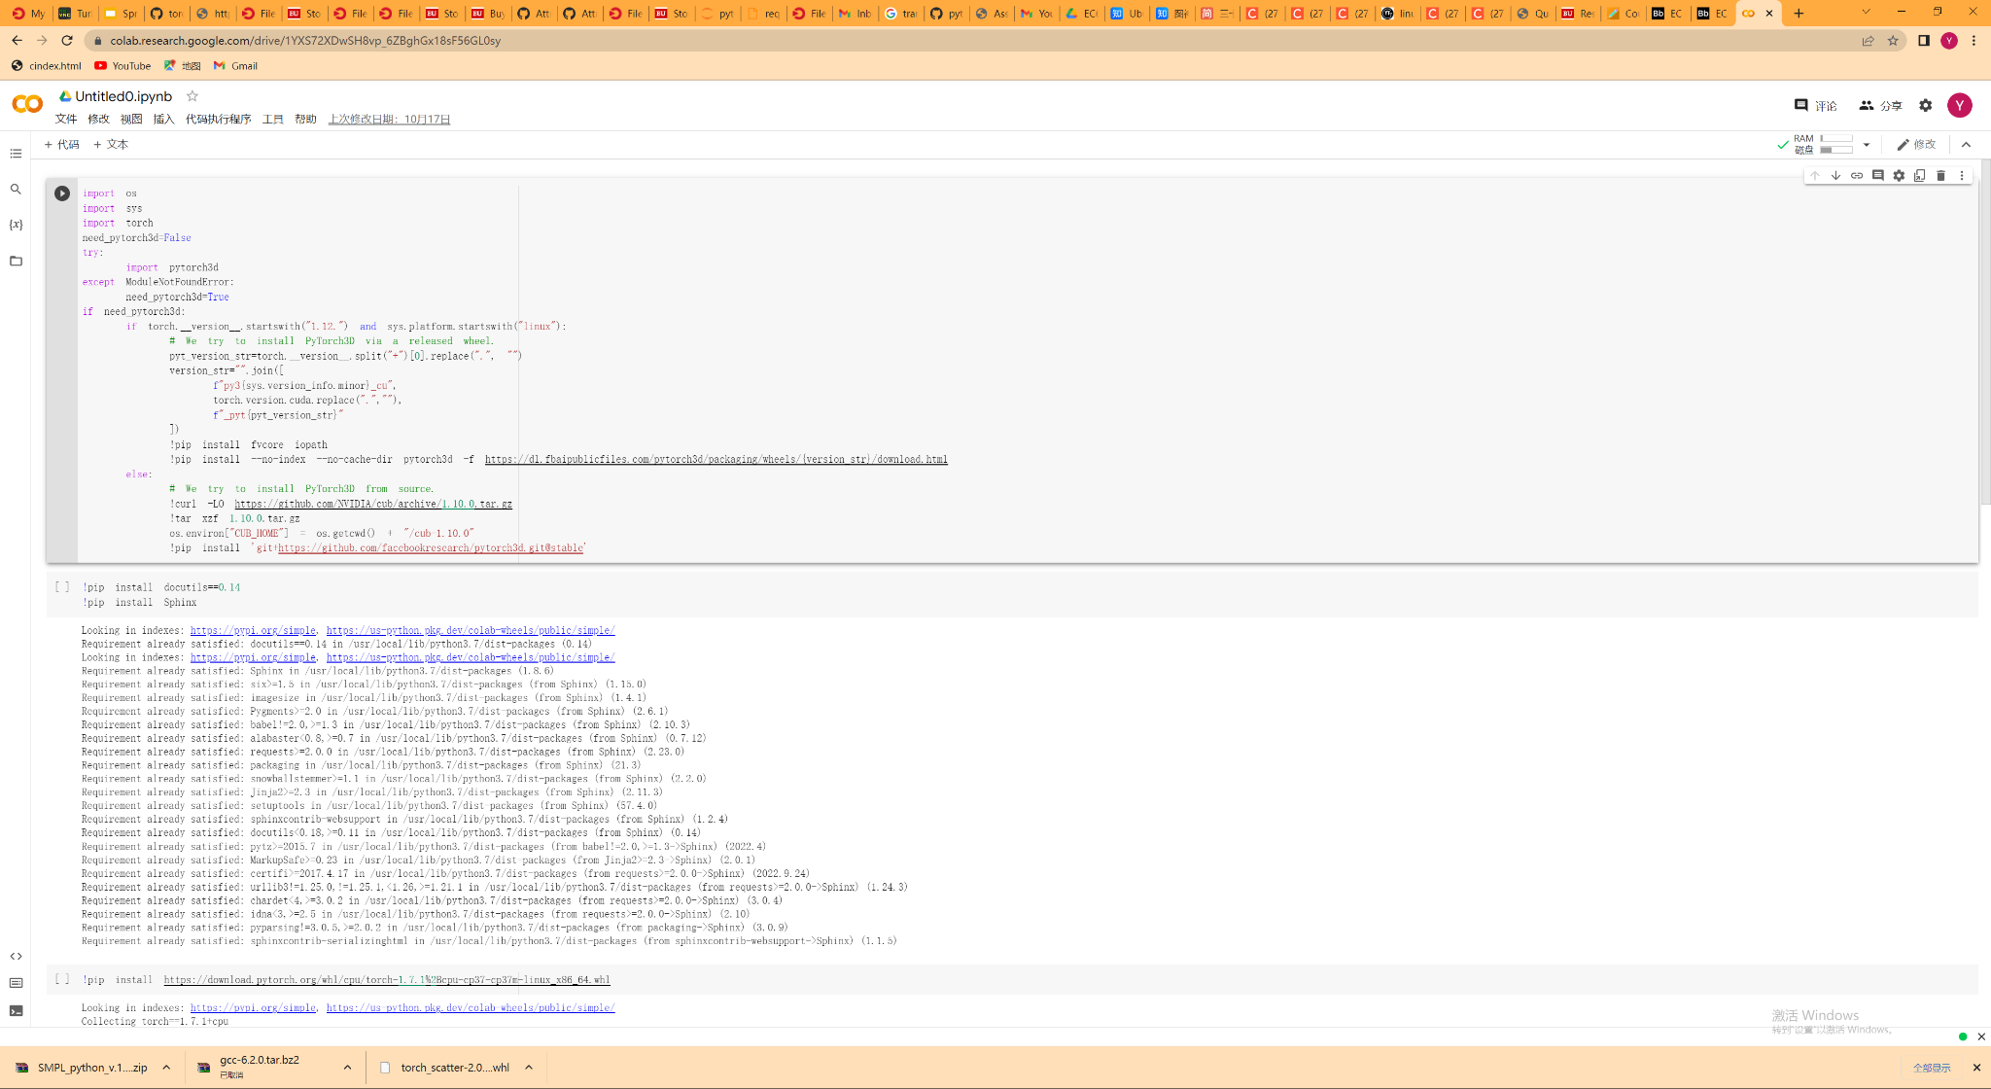
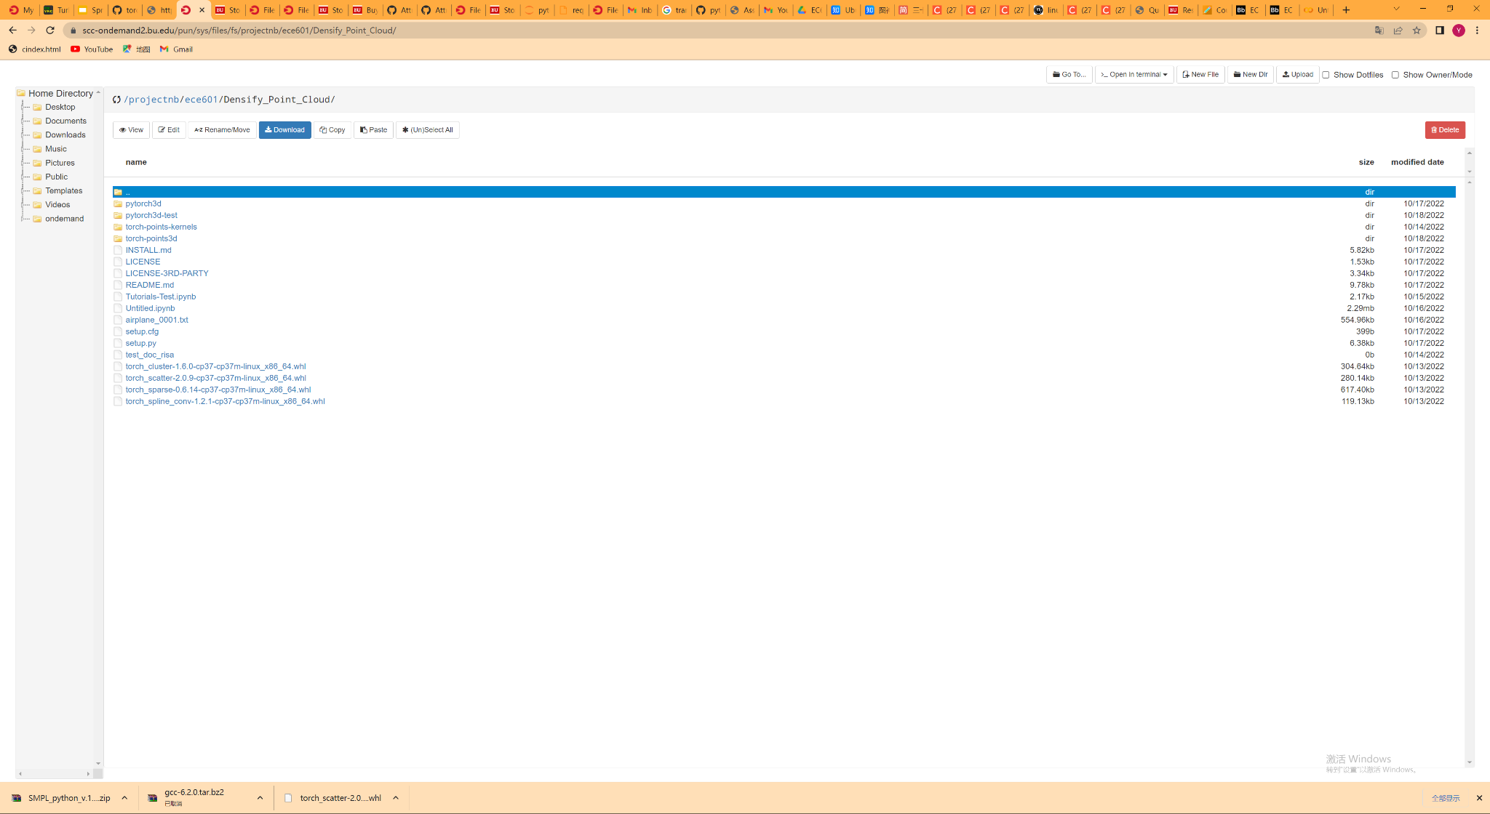

Slide 4
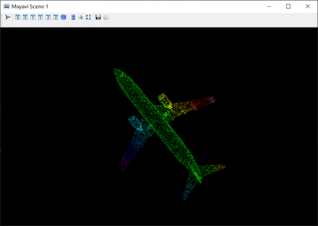
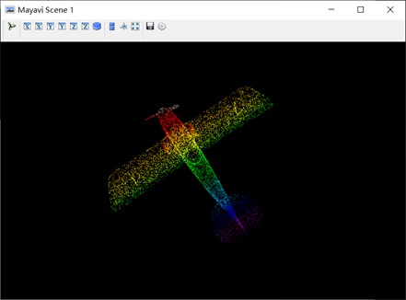
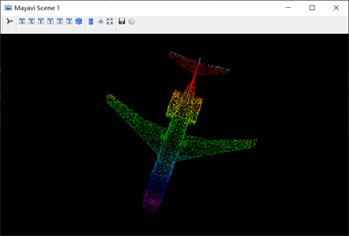
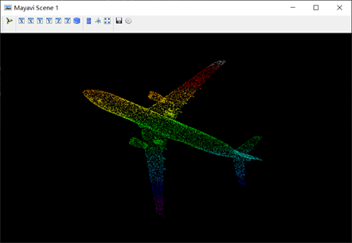
Different dataset visualization
Fig1. point cloud images

Slide 5

Demo for Point Cloud 3D Model
Fig2. Point Cloud Illustration

Slide 6
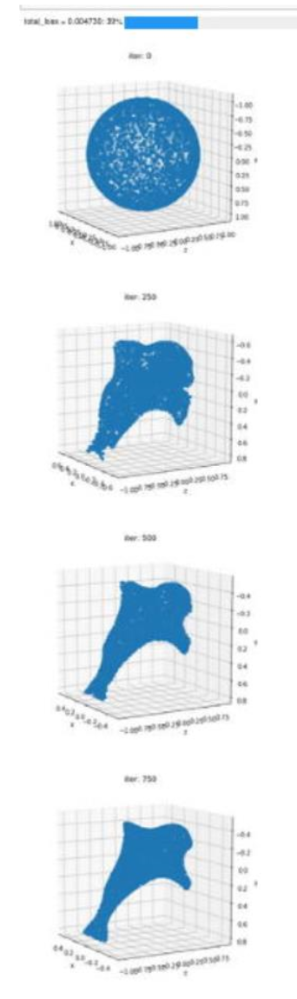
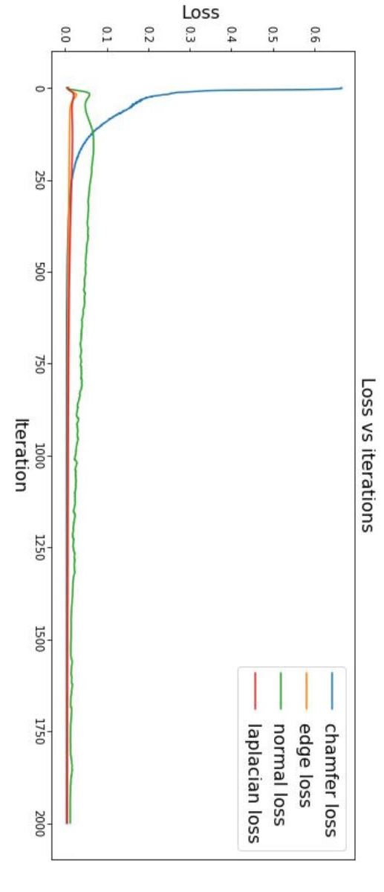
Dense deformation and Training Process
Using Pytorch 3d modules to train and deform a ball into a dolphin
GPU version == cuda 11.1
Torch version == 1.8.1
Chamfer Loss: compare the two sets of Point Clouds by computing the chamfer loss
Edge Loss: the edge length of the predicted mesh
Normal Loss: mesh normal consistency
Laplacian Loss: mesh laplacian smoothing
Fig3. Dense deform

Slide 7
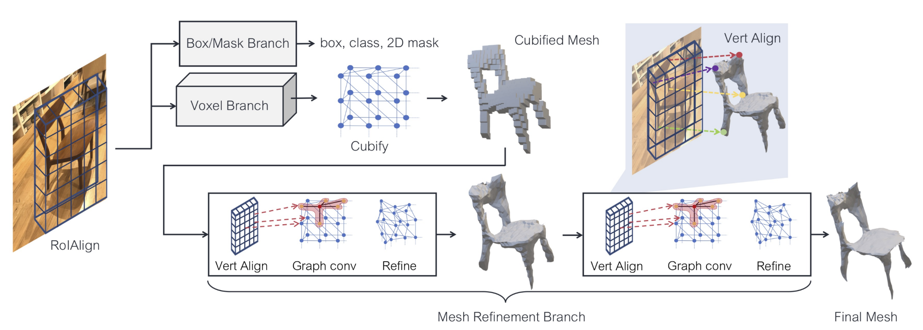
ICCV-2019 Mesh R-CNN
Fig4. Principle for mesh R-CNN

Slide 8
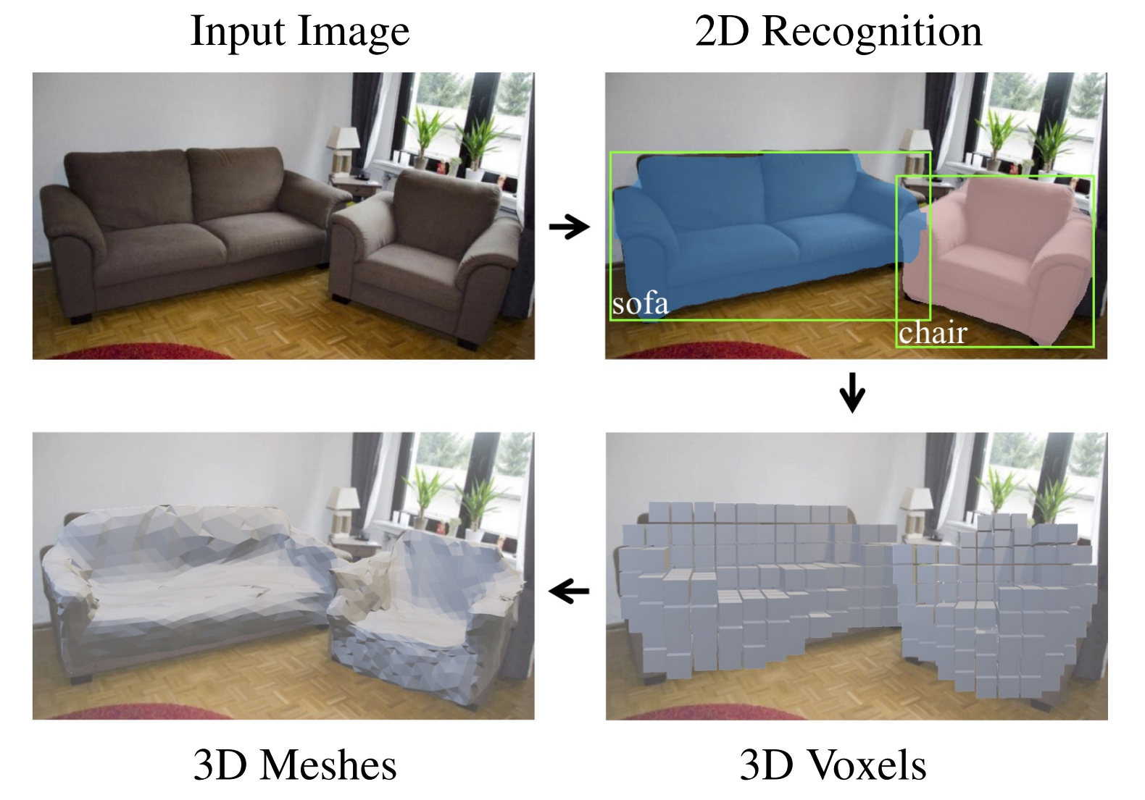
ICCV-2019 Mesh R-CNN
Fig.5 Visualization

Slide 9
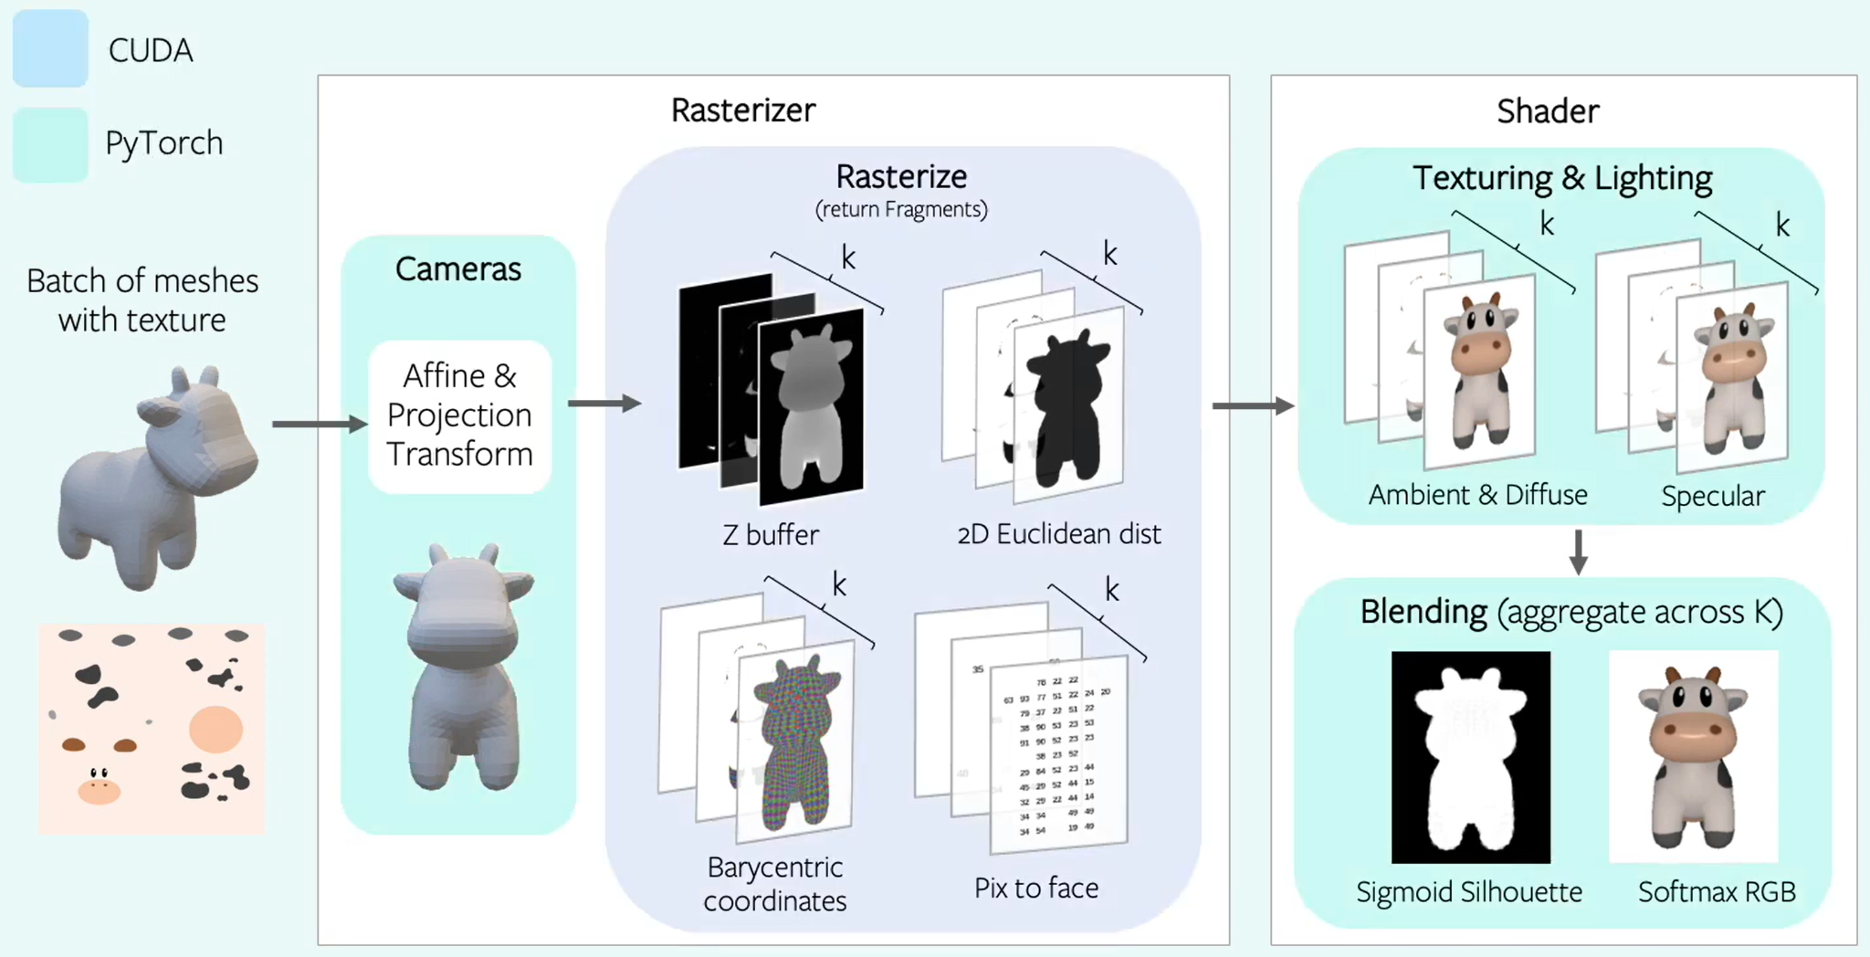
Principle of Rendering Texture

Slide 10
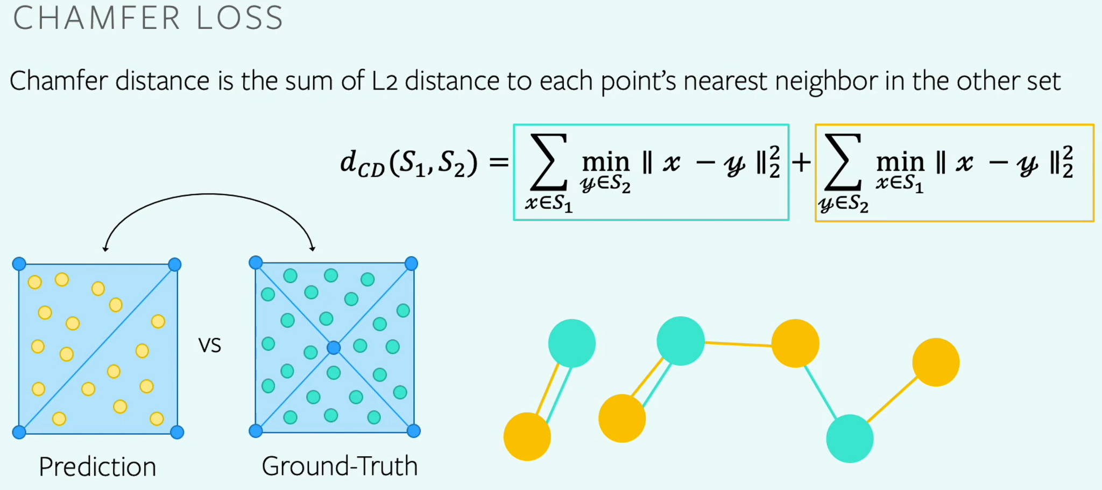
Loss Function

Slide 11
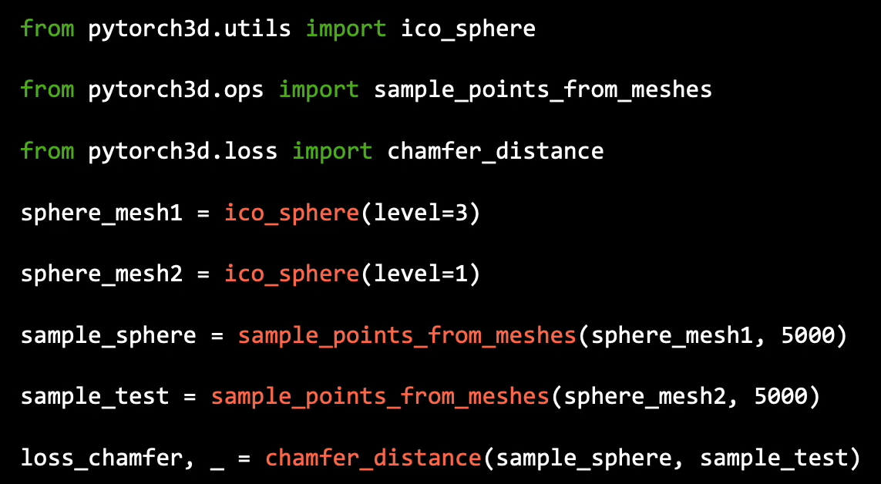
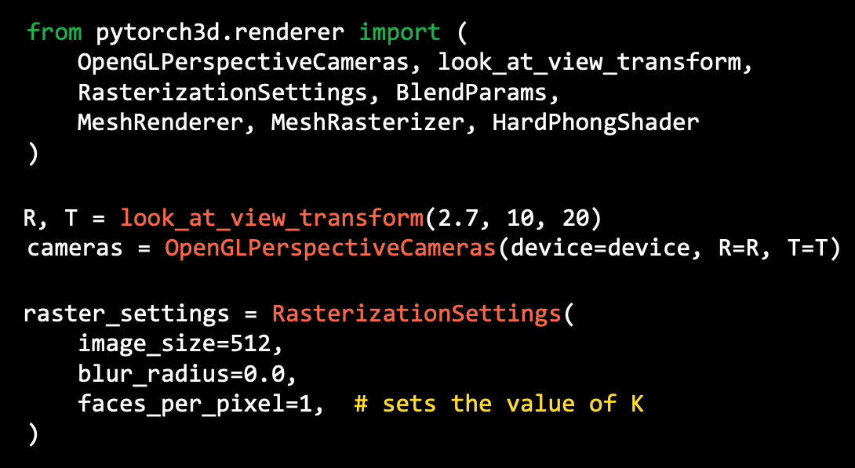
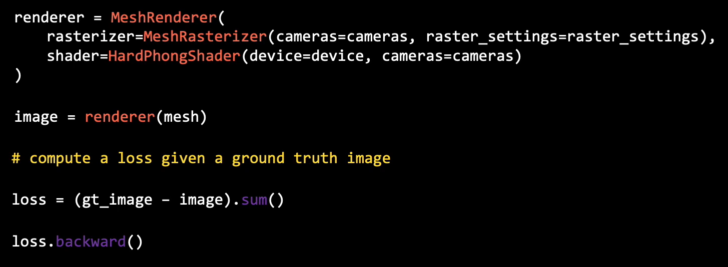
Code for the Mesh Algorithm

Slide 12
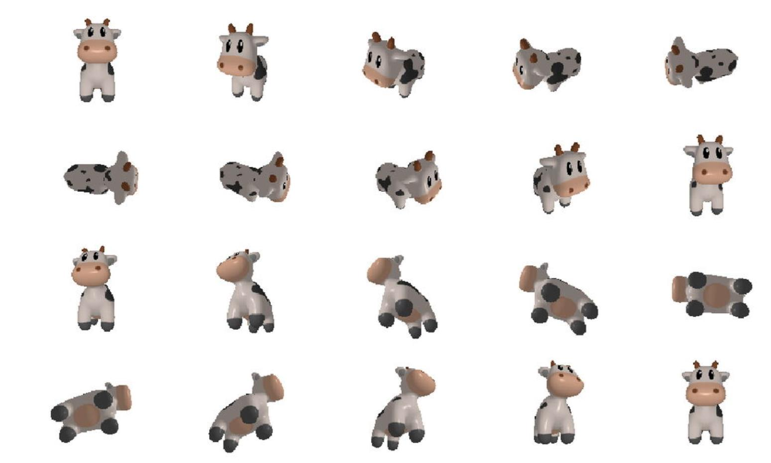
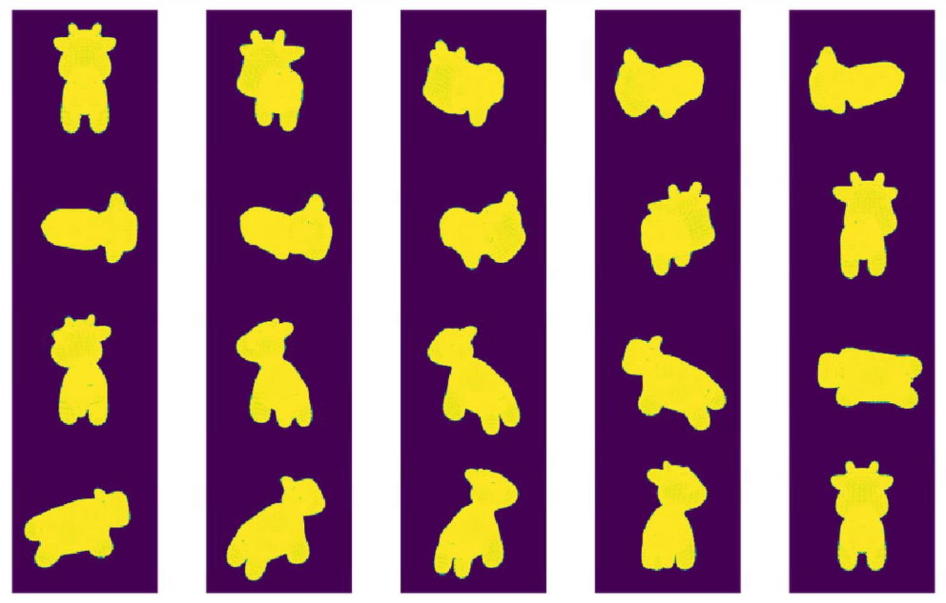

Rendering Texture

Slide 13
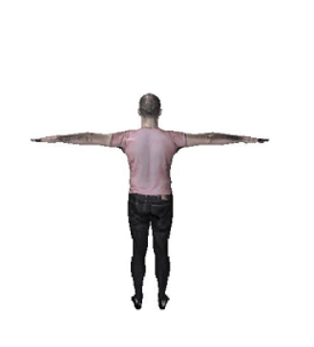
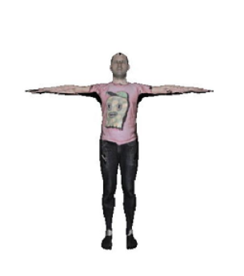
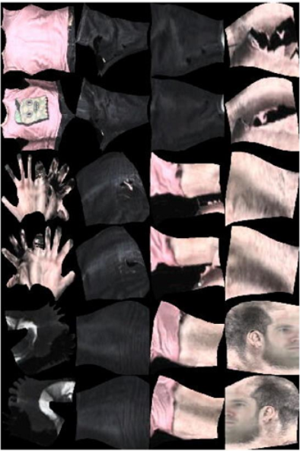
Rendering Texture
Fig3. Rendering 3D models based on 2D features

